Slide 1

Chapter 4
Enhanced Entity-Relationship (EER) Modeling
Dr. Mohamed Maher

Slide 2
Chapter Outline
■
■
EER stands for Enhanced ER or Extended ER EER Model Concepts
■
■
Includes all modeling concepts of basic ER Additional concepts:
■
subclasses/superclasses specialization/generalization categories (UNION types)
attribute and relationship inheritance
■
■
■
■
These are fundamental to conceptual modeling
■
The additional EER concepts are used to model applications more completely and more accurately
■
EER includes some object-oriented concepts, such as inheritance

Slide 3
Subclasses and Superclasses (1)
An entity is defined by attributes it possesses and relationship types in which it participates.
An entity type may have additional meaningful subgroupings of its entities
■
Example: EMPLOYEE may be further grouped into:
■
SECRETARY, ENGINEER, TECHNICIAN, …
■
Based on the EMPLOYEE’s Job
■
MANAGER
■
EMPLOYEEs who are managers
■
SALARIED_EMPLOYEE, HOURLY_EMPLOYEE
■
Based on the EMPLOYEE’s method of pay
■
EER diagrams extend ER diagrams to represent these additional subgroupings, called subclasses or subtypes

Slide 4
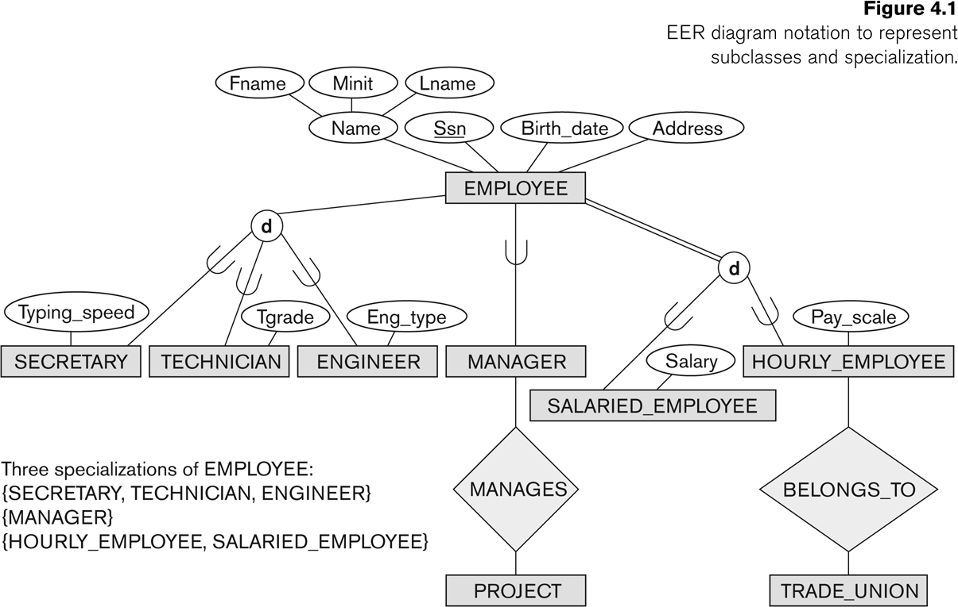
Subclasses and Superclasses

Slide 5
Subclasses and Superclasses (2)
■
Each of these subgroupings is a subset of EMPLOYEE entities
Each is called a subclass of EMPLOYEE
EMPLOYEE is the superclass for each of these subclasses
These are called superclass/subclass relationships:
■
■
■
■
EMPLOYEE/SECRETARY EMPLOYEE/TECHNICIAN EMPLOYEE/MANAGER
…
■
■
■

Slide 6
Subclasses and Superclasses (3)
These are also called IS-A relationships
SECRETARY IS-A EMPLOYEE, TECHNICIAN IS-A EMPLOYEE, ….
Note: An entity that is member of a subclass represents the same real-world entity as some member of the superclass:
An entity cannot exist in the database merely by being a member of a subclass; it must also be a member of the superclass
Notes:
لا يمكن أن يوجد كيان في قاعدة البيانات بمجرد كونه عضوًا في فئة فرعية ؛ يجب أن يكون أيضًا عضوًا في الطبقة العليا

Slide 7
Subclasses and Superclasses (4)
A member of the superclass can be optionally included as a member of any number of its subclasses
■
Examples:
■
A salaried employee who is also an engineer belongs to the two subclasses:
■
ENGINEER, and SALARIED_EMPLOYEE
■
■
A salaried employee who is also an engineering manager belongs to the three subclasses:
■
MANAGER, ENGINEER, and SALARIED_EMPLOYEE
■
■
■
It is not necessary that every entity in a superclass be a member of some subclass

Slide 8
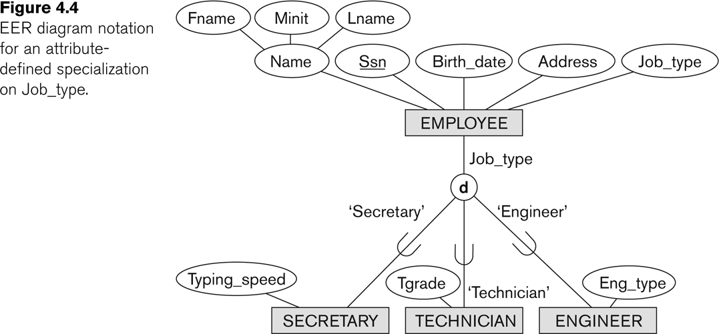
Representing Specialization in EER Diagrams

Slide 9
Attribute Inheritance in Superclass / Subclass Relationships
An entity that is member of a subclass inherits
■
All attributes of the entity as a member of the superclass
All relationships of the entity as a member of the superclass
■
Example:
■
In the previous slide, SECRETARY (as well as TECHNICIAN and ENGINEER) inherit the attributes Name, SSN, …, from EMPLOYEE
Every SECRETARY entity will have values for the inherited attributes
■

Slide 10
Specialization (1)
Specialization is the process of defining a set of subclasses of a superclass
The set of subclasses is based upon some distinguishing characteristics of the entities in the superclass
■
Example: {SECRETARY, ENGINEER,
TECHNICIAN} is a specialization of EMPLOYEE based upon job type.
■
May have several specializations of the same superclass

Slide 11
Specialization (2)
■
Example: Another specialization of EMPLOYEE based on method of pay is {SALARIED_EMPLOYEE, HOURLY_EMPLOYEE}.
■
Superclass/subclass relationships and specialization can be diagrammatically represented in EER diagrams
Attributes of a subclass are called specific or local
attributes.
■
■
For example, the attribute TypingSpeed of SECRETARY
■
The subclass can also participate in specific relationship types.
■
For example, a relationship BELONGS_TO of HOURLY_EMPLOYEE

Slide 12
Specialization (3)

Slide 13
Generalization
■
Generalization is the reverse of the specialization process
Several classes with common features are generalized into a superclass;
■
■
original classes become its subclasses
■
Example: CAR, TRUCK generalized into VEHICLE;
■
both CAR, TRUCK become subclasses of the superclass VEHICLE.
We can view {CAR, TRUCK} as a specialization of VEHICLE
Alternatively, we can view VEHICLE as a generalization of CAR and TRUCK
■
■

Slide 14
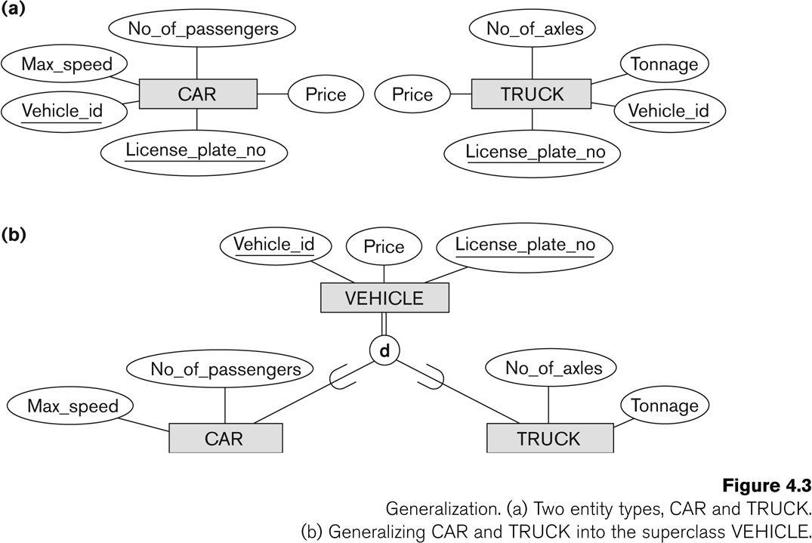
Generalization (2)

Slide 15
Generalization and Specialization (1)
■
Diagrammatic notation are sometimes used to distinguish between generalization and specialization
■
Arrow pointing to the generalized superclass represents a generalization
Arrows pointing to the specialized subclasses represent a specialization
We do not use this notation because it is often subjective as to which process is more appropriate for a particular situation
We advocate not drawing any arrows
■
■
■

Slide 16
Generalization and Specialization (2)
■
Data Modeling with Specialization and Generalization
■
A superclass or subclass represents a collection (or set or grouping) of entities
It also represents a particular type of entity
Shown in rectangles in EER diagrams (as are entity types)
We can call all entity types (and their corresponding collections) classes, whether they are entity types, superclasses, or subclasses
■
■
■

Slide 17
Constraints on Specialization and Generalization (1)
If we can determine exactly those entities that will become members of each subclass by a condition, the subclasses are called predicate- defined (or condition-defined) subclasses
■
Condition is a constraint that determines subclass members
Display a predicate-defined subclass by writing the predicate condition next to the line attaching the subclass to its superclass
■

Slide 18
Constraints on Specialization and Generalization (2)
■
If all subclasses in a specialization have membership condition on same attribute of the superclass, specialization is called an attribute-defined specialization
■
■
Attribute is called the defining attribute of the specialization
Example: JobType is the defining attribute of the specialization {SECRETARY, TECHNICIAN, ENGINEER} of EMPLOYEE
■
If no condition determines membership, the subclass is called user-defined
■
Membership in a subclass is determined by the database users by applying an operation to add an entity to the subclass
Membership in the subclass is specified individually for each entity in the superclass by the user
■

Slide 19
Displaying an attribute-defined specialization in EER diagrams

Slide 20
Constraints on Specialization and Generalization (3)
■
Two basic constraints can apply to a specialization/generalization:
Disjointness Constraint Completeness Constraint
■
■
Slide 4- 20

Slide 21
Constraints on Specialization and Generalization (4)
■
Disjointness Constraint:
■
Specifies that the subclasses of the specialization must be disjoint:
an entity can be a member of at most one of the subclasses of the specialization
Specified by d in EER diagram
If not disjoint, specialization is overlapping:
■
■
■
that is the same entity may be a member of more than one subclass of the specialization
Specified by o in EER diagram
■
■

Slide 23
Constraints on Specialization and Generalization (5)
■
Completeness Constraint:
■
Total specifies that every entity in the superclass must be a member of some subclass in the specialization/generalization
Shown in EER diagrams by a double line
Partial allows an entity not to belong to any of the subclasses
Shown in EER diagrams by a single line
■
■
■

Slide 24
Specialization (3)

Slide 25
Constraints on Specialization and Generalization (6)
■
Hence, we have four types of specialization/generalization:
Disjoint, total Disjoint, partial Overlapping, total Overlapping, partial
■
■
■
■
■
Note: Generalization usually is total because the superclass is derived from the subclasses.

Slide 26
Example of disjoint partial Specialization

Slide 27
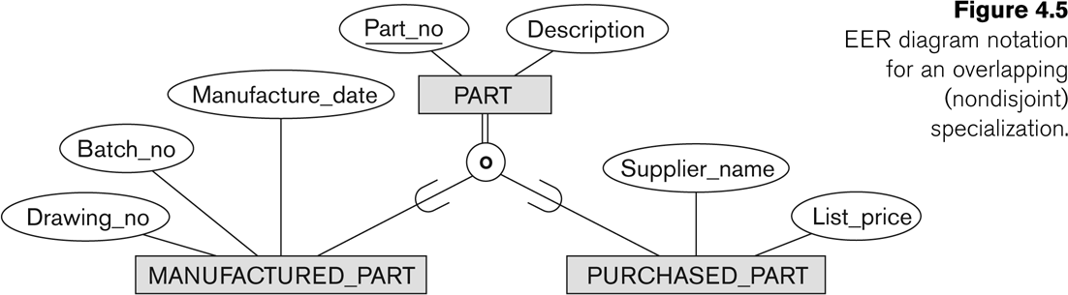
Example of overlapping total Specialization

Slide 28
Specialization/Generalization Hierarchies, Lattices & Shared Subclasses (1)
■
A subclass may itself have further subclasses specified on it
■
forms a hierarchy or a lattice
■
Hierarchy has a constraint that every subclass has only one superclass (called single inheritance); this is basically a tree structure
In a lattice, a subclass can be subclass of more than one superclass (called multiple inheritance)
■

Slide 29
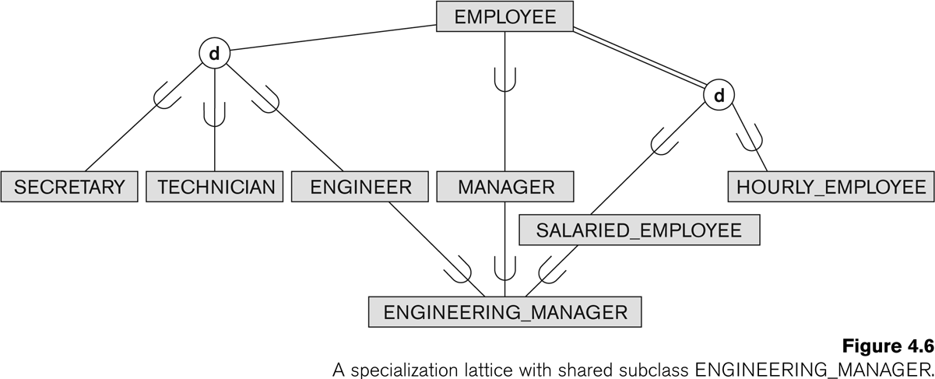
Shared Subclass “Engineering_Manager”

Slide 30
Specialization/Generalization Hierarchies, Lattices & Shared Subclasses (2)
■
In a lattice or hierarchy, a subclass inherits attributes not only of its direct superclass, but also of all its predecessor superclasses
A subclass with more than one superclass is called a shared subclass (multiple inheritance)
Can have:
■
■
■
specialization hierarchies or lattices, or generalization hierarchies or lattices, depending on how they were derived
■
■
■
We just use specialization (to stand for the end result of either specialization or generalization)

Slide 31
Specialization/Generalization Hierarchies, Lattices & Shared Subclasses (3)
■
In specialization, start with an entity type and then define subclasses of the entity type by successive specialization
■
called a top down conceptual refinement process
■
In generalization, start with many entity types and generalize those that have common properties
■
Called a bottom up conceptual synthesis process
■
In practice, a combination of both processes is usually employed

Slide 32
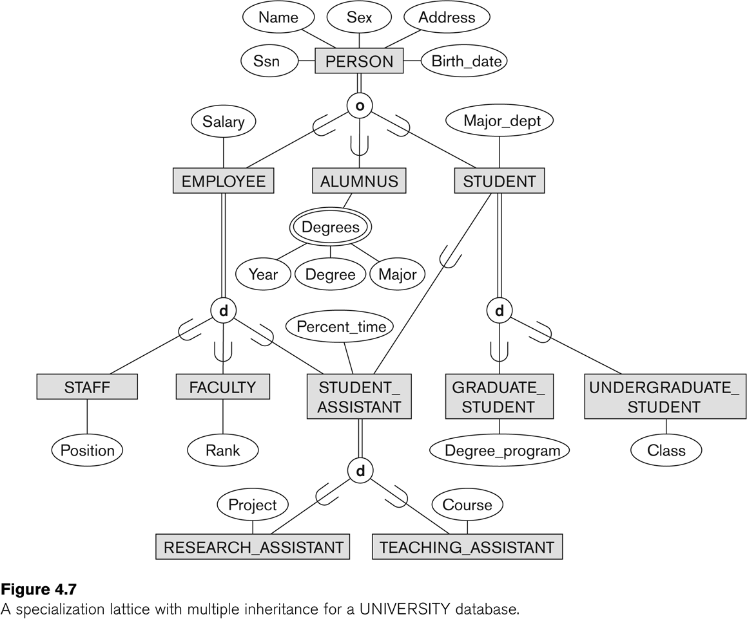
Specialization / Generalization Lattice Example (UNIVERSITY)

Slide 33
Categories (UNION TYPES) (1)
■
All of the superclass/subclass relationships we have seen thus far have a single superclass
A shared subclass is a subclass in:
■
■
more than one distinct superclass/subclass relationships each relationships has a single superclass
shared subclass leads to multiple inheritance
■
■
■
In some cases, we need to model a single superclass/subclass relationship with more than one superclass
Superclasses can represent different entity types Such a subclass is called a category or UNION TYPE
■
■

Slide 34
Categories (UNION TYPES) (2)
A category (UNION type) called OWNER is created to represent a subset of the union of the three superclasses COMPANY, BANK, and PERSON
A category member must exist in at least one of its superclasses
■
Example: In a database for vehicle registration, a vehicle owner can be a PERSON, a BANK (holding a lien on a vehicle) or a COMPANY.
■
■
■
Difference from shared subclass, which is a:
■
subset of the intersection of its superclasses
shared subclass member must exist in all of its superclasses
■

Slide 35
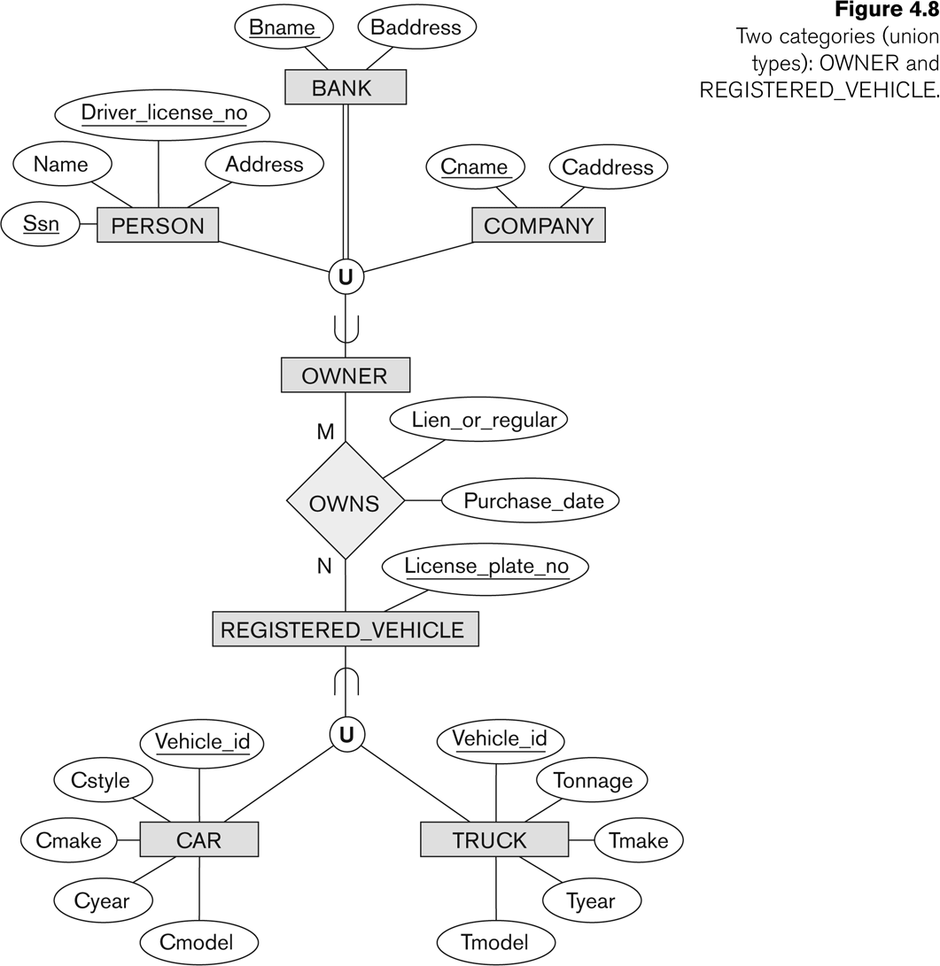
Two categories (UNION types): OWNER, REGISTERED_VEHICLE

Slide 36
Summary
■
Introduced the EER model concepts
Class/subclass relationships Specialization and generalization Inheritance
■
■
■
■
These augment the basic ER model concepts introduced in Chapter 3
EER diagrams and alternative notations were presented
■

